Slide 1

Database Lab 8 NULL and Subquery Addendum
Dr. Jefferson Fong

Slide 2
Announcements
Project Description is due Nov 10.
See last lecture’s addendum for details.

Slide 3
Slide 3-7
In your sakila database, does table staff have the attribute staff_rating?
Click table staff and see.
If staff_rating is missing, add it to table staff with these 2 queries.
Recall alter table in Lab 6.
ALTER TABLE staff ADD staff_rating INT(11) DEFAULT NULL;
Recall update in Lab 7; be careful with the quotes if you paste!
UPDATE staff SET staff_rating = 10
WHERE first_name=‘Mike’ AND last_name=‘Hillyer’;
UPDATE staff SET staff_rating = NULL
WHERE first_name=‘Jon’ AND last_name=‘Stephens’;
Click table staff to see if staff_rating has the correct values now.
The queries in “Sakila Update.txt” also works; I created this slide before the convener put “Sakila Update.txt” in iSpace.

Slide 4
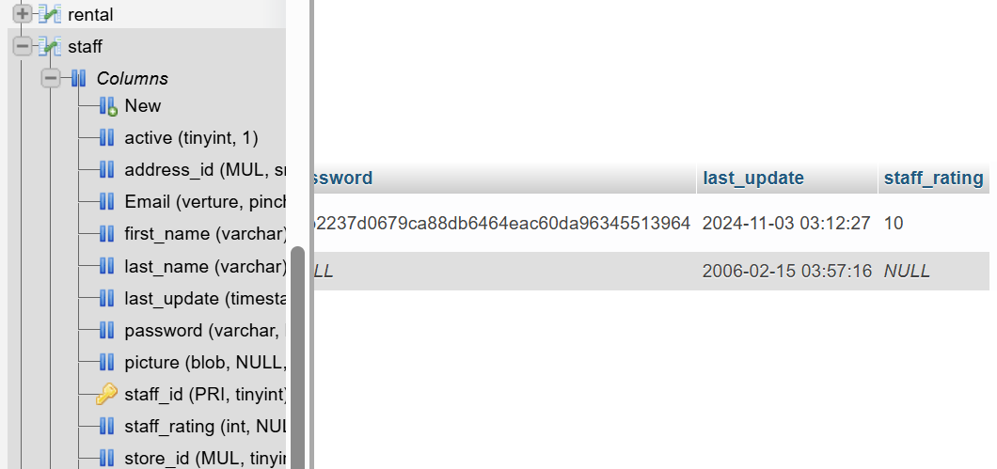
If correct, save a copy of the updated database.
Click sakila > Export tab > Go
Rename the download file to sakila_new.sql, and store it in your computer or memory stick, next to your old sakila.sql file.

Slide 5
Slide 4
Excel’s aggregation functions basically work the same way.
Slide 5
Comparison with NULL:
If b is NULL, then b is evaluated as UNKNOWN in the comparison (b > 5)
The expression (b > 5) is UNKNOWN because we don’t know the value of b.
Slide 6
If b is unknown, then
(b OR true) = true
Doesn’t matter whether b turned out to be true, false or unknown.
(true AND b) = unknown
If b turned out to be T, the total result is T, otherwise, the total result is F; we don’t know at this instance.

Slide 6
Slide 9
Do the subquery first.
SELECT film_id
FROM film
WHERE rating = 'PG-13’
And store the result in the table temp.
Then do the main query.
SELECT actor_id
FROM film_actor NATURAL JOIN temp
Check the tables film and film_actor.
Run the subquery first. Then predict the result when you run the main query.

Slide 7
Walk the tables first. Check the tables in sakila.sql
Exercise 1 (c.f. Lab 4 Exercise 1)
Actor(actor_id, first_name, last_name)
Film_actor(actor_id, film_id)
Film(film_id, title)
Exercise 2 (c.f. Lab 4, Exercise 2)
Customer(customer_id, first_name, last_name)
Rental(customer_id, inventory_id)
Inventory(inventory_id, film_id)
Film(film_id, title)

Slide 8
Exercise 6
C.f. Lab 5 Aggregations

Slide 9


